Slide 1
Progress Report – Multicontact Capturability
GABRIEL ENRIQUE GARCÍA CHÁVEZ
2019

Slide 2

Full Reduced Inverted Pendulum
Reduced Model of a mechanism:
$$\left\{\begin{aligned}\dot{L}=\sum_{i}{\left(τ_{i}{\hat{n}}_{i}+\left(r_{p0}−r\right)×f_{i}\right)} \\ \ddot{r}=\frac{1}{m}\sum_{i}{f_{i}}+g \end{aligned}\right.$$

Slide 3

Full Reduced Inverted Pendulum
Using CWC on each surface:
$$ζ_{i}=\left[\begin{aligned}f_{i} \\ τ_{i}\end{aligned}\right],ζ_{v}=\left[\begin{aligned}ζ_{1} \\ ⋮ \\ ζ_{n}\end{aligned}\right]$$
$$\left\{\begin{aligned}\dot{L}=\sum_{i}{\left(τ_{i}+\left(r_{p0i}−r\right)×f_{i}\right)} \\ \ddot{r}=\frac{1}{m}\sum_{i}{f_{i}}+g \end{aligned}\right.,W_{CWCi}ζ_{i}≤b_{CWCi},W_{bCWC}ζ_{v}≤b_{bCWC}$$
Use instead
$$f=\sum_{i}{f_{i}}$$
$$τ=\sum_{i}{\left(τ_{i}+\left(r_{p0i}\right)×f_{i}\right)}$$

Slide 4
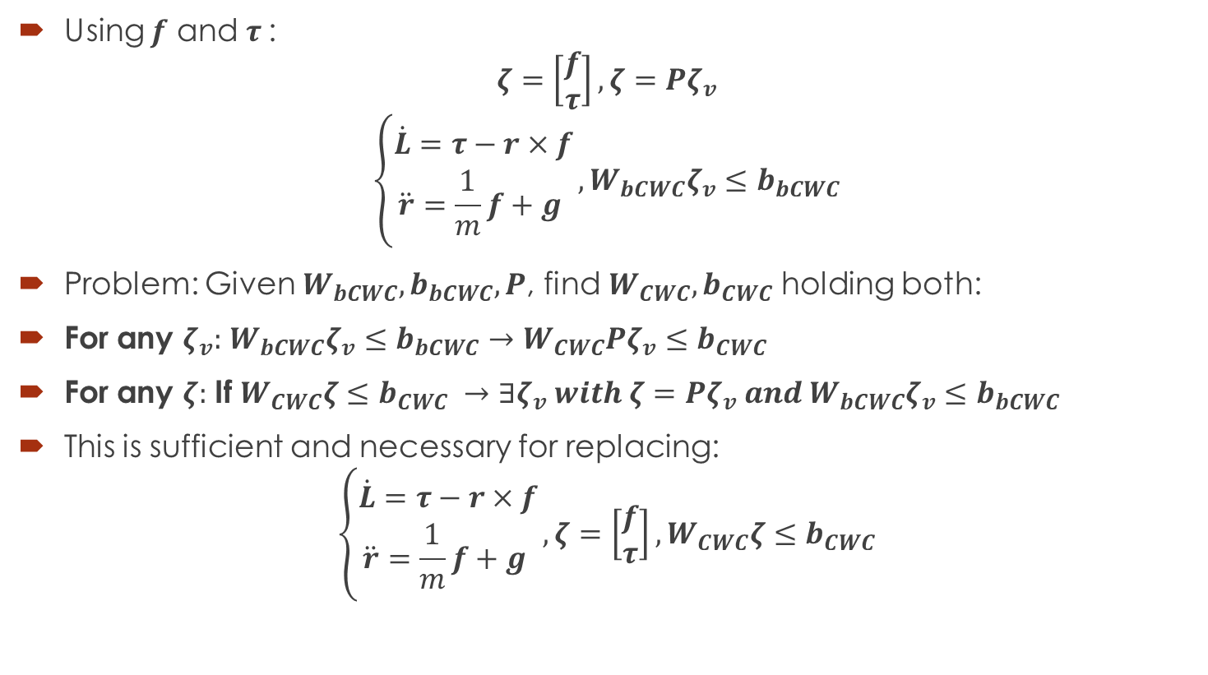
Full Reduced Inverted Pendulum
Using $f$ and $τ$:
$$ζ=\left[\begin{aligned}f \\ τ\end{aligned}\right],ζ=Pζ_{v}$$
$$\left\{\begin{aligned}\dot{L}=τ−r×f \\ \ddot{r}=\frac{1}{m}f+g \end{aligned}\right.,W_{bCWC}ζ_{v}≤b_{bCWC}$$
Problem: Given $W_{bCWC}, b_{bCWC},P$, find $W_{CWC},b_{CWC}$ holding both:
For any $ζ_{v}:$ $W_{bCWC}ζ_{v}≤b_{bCWC}→W_{CWC}Pζ_{v}≤b_{CWC}$
For any $ζ:$ If $W_{CWC}ζ≤b_{CWC} →∃ζ_{v} with ζ=Pζ_{v} and W_{bCWC}ζ_{v}≤b_{bCWC}$
This is sufficient and necessary for replacing:
$$\left\{\begin{aligned}\dot{L}=τ−r×f \\ \ddot{r}=\frac{1}{m}f+g \end{aligned}\right.,ζ=\left[\begin{aligned}f \\ τ\end{aligned}\right],W_{CWC}ζ≤b_{CWC}$$

Slide 5
Full Reduced Inverted Pendulum
Using $f$ and $τ$:
$$ζ=\left[\begin{aligned}f \\ τ\end{aligned}\right],ζ=Pζ_{v}$$
$$\left\{\begin{aligned}\dot{L}=τ−r×f \\ \ddot{r}=\frac{1}{m}f+g \end{aligned}\right.,W_{bCWC}ζ_{v}≤b_{bCWC}$$
Problem: Given $W_{bCWC}, b_{bCWC},P$, find $W_{CWC},b_{CWC}$ holding both:
For any $ζ_{v}:$ $W_{bCWC}ζ_{v}≤b_{bCWC}→W_{CWC}Pζ_{v}≤b_{CWC}$
For any $ζ:$ If $W_{CWC}ζ≤b_{CWC} →∃ζ_{v} with ζ=Pζ_{v} and W_{bCWC}ζ_{v}≤b_{bCWC}$
This is sufficient and necessary for replacing:
$$\left\{\begin{aligned}\dot{L}=τ−r×f \\ \ddot{r}=\frac{1}{m}f+g \end{aligned}\right.,ζ=\left[\begin{aligned}f \\ τ\end{aligned}\right],W_{CWC}ζ≤b_{CWC}$$

Slide 6
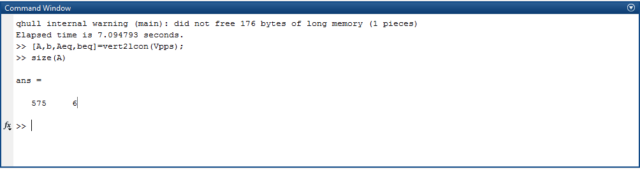

Full Reduced Inverted Pendulum
Problem: Given $W_{bCWC}, b_{bCWC},P$, find $W_{CWC},b_{CWC}$ holding both:
For any $ζ_{v}:$ $W_{bCWC}ζ_{v}≤b_{bCWC}→W_{CWC}Pζ_{v}≤b_{CWC}$
For any $ζ:$ If $W_{CWC}ζ≤b_{CWC} →∃ζ_{v} with ζ=Pζ_{v} and W_{bCWC}ζ_{v}≤b_{bCWC}$

Slide 7

Full Reduced Inverted Pendulum
In $ζ_{v}$:
$$ζ_{i}=\left[\begin{aligned}f_{i} \\ τ_{i}\end{aligned}\right],ζ_{v}=\left[\begin{aligned}ζ_{1} \\ ⋮ \\ ζ_{n}\end{aligned}\right]$$
$$\left\{\begin{aligned}\dot{L}=\sum_{i}{\left(τ_{i}+\left(r_{p0i}−r\right)×f_{i}\right)} \\ \ddot{r}=\frac{1}{m}\sum_{i}{f_{i}}+g \end{aligned}\right.,W_{bCWC}ζ_{v}≤b_{bCWC}$$
Use instead
$$L_{2}=L+m(r×\dot{r})$$

Slide 8

Full Reduced Inverted Pendulum
Using $L_{2}$:
$$ζ_{i}=\left[\begin{aligned}f_{i} \\ τ_{i}\end{aligned}\right],ζ_{v}=\left[\begin{aligned}ζ_{1} \\ ⋮ \\ ζ_{n}\end{aligned}\right]$$
$$\left\{\begin{aligned}{\dot{L}}_{2}=\sum_{i}{τ_{i}}+\sum_{i}{{\left[r_{p0i}\right]}_{×}f_{i}}+mr×g \\ \ddot{r}=\frac{1}{m}\sum_{i}{f_{i}}+g \end{aligned}\right.,W_{bCWC}ζ_{v}≤b_{bCWC}$$

Slide 9
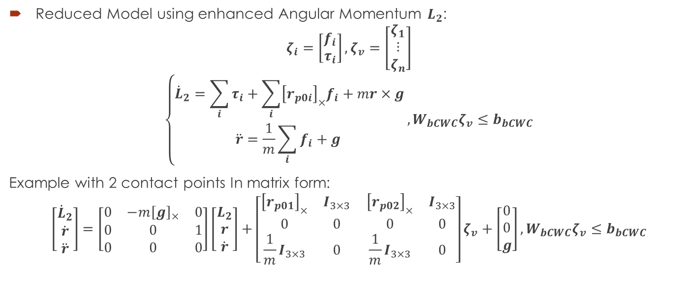
Full Reduced Inverted Pendulum
Reduced Model using enhanced Angular Momentum $L_{2}$:
$$ζ_{i}=\left[\begin{aligned}f_{i} \\ τ_{i}\end{aligned}\right],ζ_{v}=\left[\begin{aligned}ζ_{1} \\ ⋮ \\ ζ_{n}\end{aligned}\right]$$
$$\left\{\begin{aligned}{\dot{L}}_{2}=\sum_{i}{τ_{i}}+\sum_{i}{{\left[r_{p0i}\right]}_{×}f_{i}}+mr×g \\ \ddot{r}=\frac{1}{m}\sum_{i}{f_{i}}+g \end{aligned}\right.,W_{bCWC}ζ_{v}≤b_{bCWC}$$
Example with 2 contact points In matrix form:
$$\left[\begin{aligned}{\dot{L}}_{2} \\ \dot{r} \\ \ddot{r}\end{aligned}\right]=\left[\begin{matrix}0 & −m{\left[g\right]}_{×} & 0 \\ 0 & 0 & 1 \\ 0 & 0 & 0\end{matrix}\right]\left[\begin{aligned}L_{2} \\ r \\ \dot{r}\end{aligned}\right]+\left[\begin{matrix}{\left[r_{p01}\right]}_{×} & I_{3×3} \\ 0 & 0 \\ \frac{1}{m}I_{3×3} & 0\end{matrix} \begin{matrix}{\left[r_{p02}\right]}_{×} & I_{3×3} \\ 0 & 0 \\ \frac{1}{m}I_{3×3} & 0\end{matrix}\right]ζ_{v}+\left[\begin{aligned}0 \\ 0 \\ g\end{aligned}\right],W_{bCWC}ζ_{v}≤b_{bCWC}$$

Slide 10
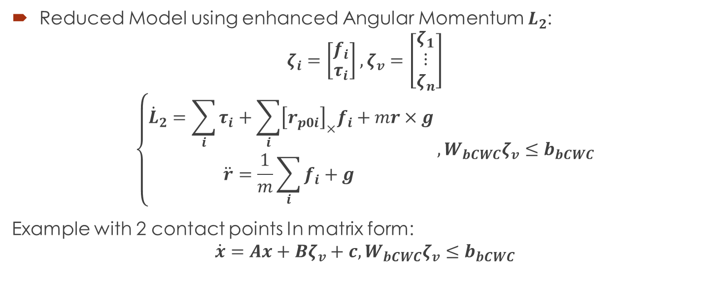
Full Reduced Inverted Pendulum
Reduced Model using enhanced Angular Momentum $L_{2}$:
$$ζ_{i}=\left[\begin{aligned}f_{i} \\ τ_{i}\end{aligned}\right],ζ_{v}=\left[\begin{aligned}ζ_{1} \\ ⋮ \\ ζ_{n}\end{aligned}\right]$$
$$\left\{\begin{aligned}{\dot{L}}_{2}=\sum_{i}{τ_{i}}+\sum_{i}{{\left[r_{p0i}\right]}_{×}f_{i}}+mr×g \\ \ddot{r}=\frac{1}{m}\sum_{i}{f_{i}}+g \end{aligned}\right.,W_{bCWC}ζ_{v}≤b_{bCWC}$$
Example with 2 contact points In matrix form:
$$\dot{x}=Ax+Bζ_{v}+c,W_{bCWC}ζ_{v}≤b_{bCWC}$$

Slide 11
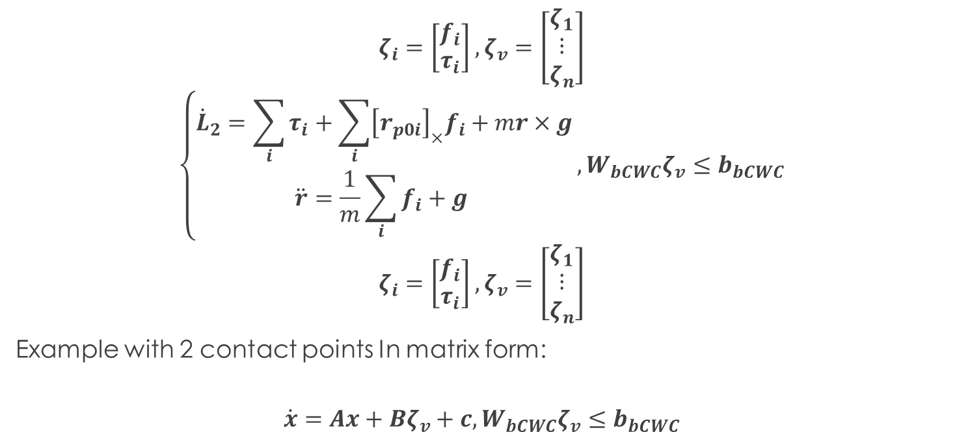
Full Reduced Inverted Pendulum
$$ζ_{i}=\left[\begin{aligned}f_{i} \\ τ_{i}\end{aligned}\right],ζ_{v}=\left[\begin{aligned}ζ_{1} \\ ⋮ \\ ζ_{n}\end{aligned}\right]$$
$$\left\{\begin{aligned}{\dot{L}}_{2}=\sum_{i}{τ_{i}}+\sum_{i}{{\left[r_{p0i}\right]}_{×}f_{i}}+mr×g \\ \ddot{r}=\frac{1}{m}\sum_{i}{f_{i}}+g \end{aligned}\right.,W_{bCWC}ζ_{v}≤b_{bCWC}$$
$$ζ_{i}=\left[\begin{aligned}f_{i} \\ τ_{i}\end{aligned}\right],ζ_{v}=\left[\begin{aligned}ζ_{1} \\ ⋮ \\ ζ_{n}\end{aligned}\right]$$
Example with 2 contact points In matrix form:
$$\dot{x}=Ax+Bζ_{v}+c,W_{bCWC}ζ_{v}≤b_{bCWC}$$

Slide 12
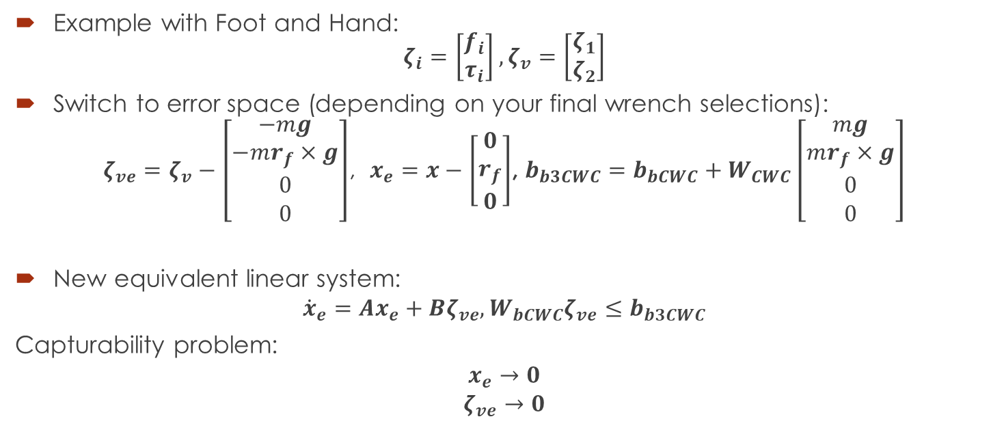
Full Reduced Inverted Pendulum
Example with Foot and Hand: $ζ_{i}=\left[\begin{aligned}f_{i} \\ τ_{i}\end{aligned}\right],ζ_{v}=\left[\begin{aligned}ζ_{1} \\ ζ_{2}\end{aligned}\right]$
Switch to error space (depending on your final wrench selections):
$ζ_{ve}=ζ_{v}−\left[\begin{aligned}−mg \\ −mr_{f}×g \\ 0 \\ 0\end{aligned}\right]$, $x_{e}=x−\left[\begin{aligned}0 \\ r_{f} \\ 0\end{aligned}\right]$, $b_{b3CWC}=b_{bCWC}+W_{CWC}\left[\begin{aligned}mg \\ mr_{f}×g \\ 0 \\ 0\end{aligned}\right]$
New equivalent linear system:
$${\dot{x}}_{e}=Ax_{e}+Bζ_{ve}, W_{bCWC}ζ_{ve}≤b_{b3CWC}$$
Capturability problem:
$$x_{e}→0$$
$$ζ_{ve}→0$$

Slide 13

Full Reduced Inverted Pendulum
First idea: Optimization:
$$\min_{ζ_{ne}}{\frac{1}{2}\int_{0}^{∞}{x_{e}^{T}Qx_{e}+ζ_{ne}^{T}Rζ_{ne}dt}}$$
Subject to:
$${\dot{x}}_{e}=Ax_{e}+Bζ_{ne}$$
$$W_{bCWC}ζ_{ve}≤b_{b3CWC}$$
$$x_{e}\left(0\right)=x_{e0}$$
Convex problem!

Slide 14
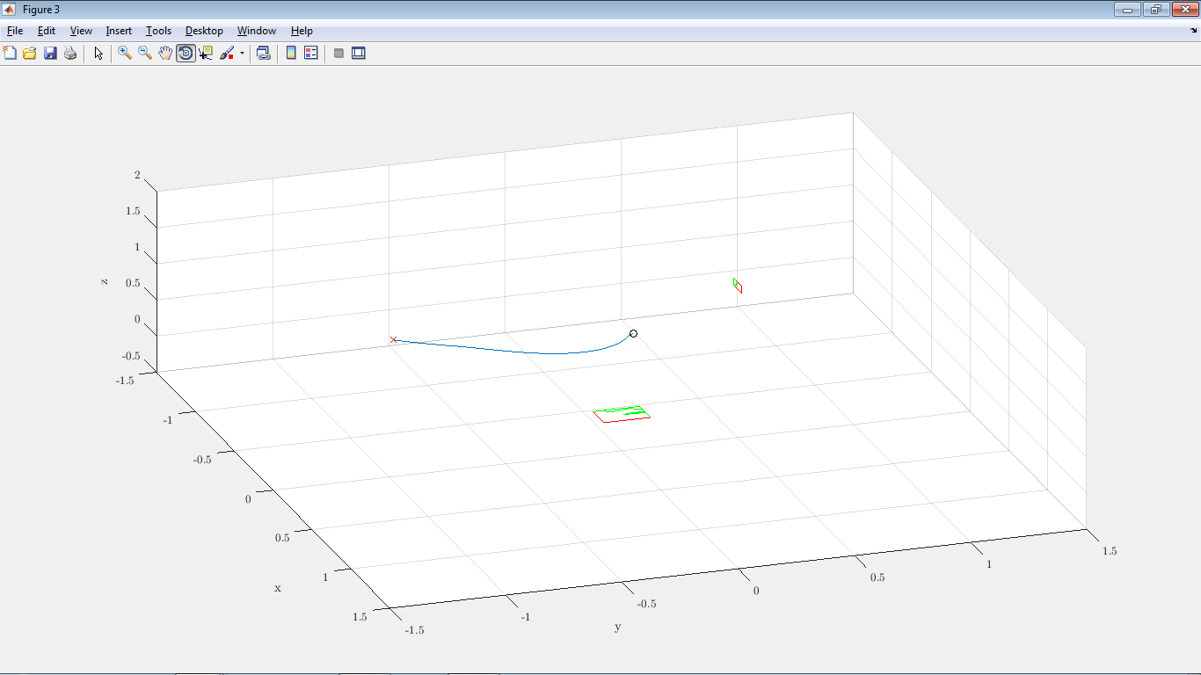
Full Reduced Inverted Pendulum
First idea: QP Optimization on the discrete system:

Slide 15
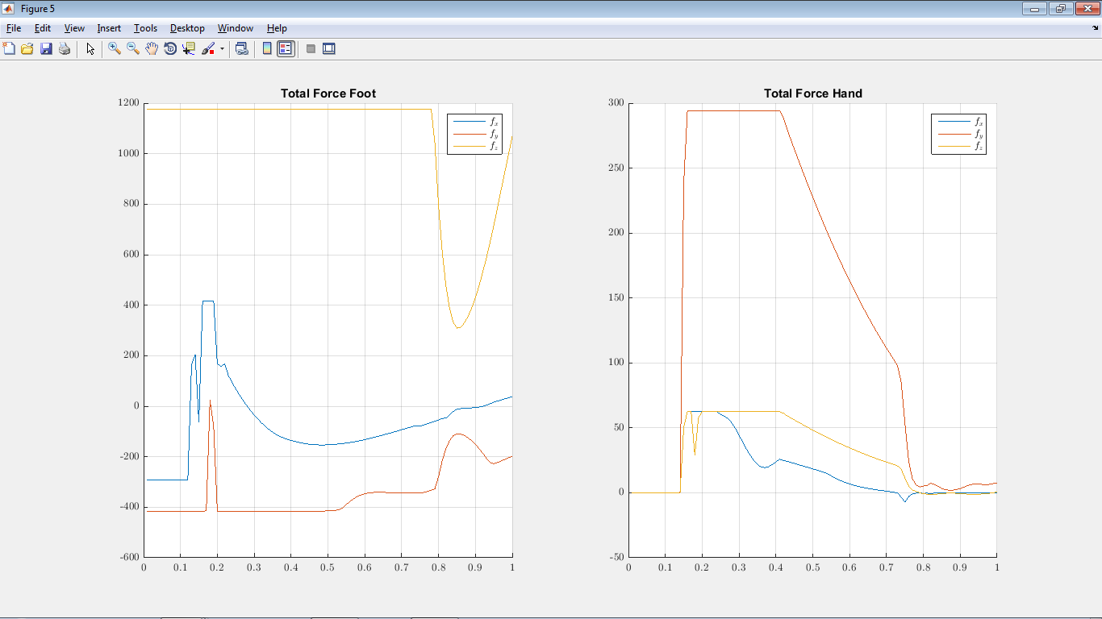
Full Reduced Inverted Pendulum
First idea: QP Optimization on the discrete system:

Slide 16







LP for finding CoMs
Finding allowed CoMs for a fixed CWC (and fixed ${\dot{r}}_{0},L_{0}$): LP program:
1. Pick a random $r_{CoM0}$ (Stabilizable, example: a point on the static stability).
2. Pick a random ${\hat{v}}_{j}$. Can be defined by two angles (2D, i.e. angles from spherical coordinates).
3.$\max_{r_{CoM1},ζ_{nei},x_{ei}}\left(r_{CoM1}−r_{CoM0}\right)∙{\hat{v}}_{j}$ s.t
$$W_{CWC}ζ_{nei}≤b_{3CWC}$$
$$x_{ei+1}=x_{ei}+ΔT\left(Ax_{ei}+Bζ_{nei}\right)$$
$$x_{eN}=x_{ef}$$
$$x_{e0}=\left[\begin{aligned}L_{0}+m(r_{CoM1}×{\dot{r}}_{0}) \\ r_{CoM1}−r_{f} \\ {\dot{r}}_{0}\end{aligned}\right]$$
$$r_{CoM0}$$
$$r_{CoM1}$$
$${\hat{v}}_{j}$$
$${\hat{v}}_{j}$$
$$ζ$$

Slide 17
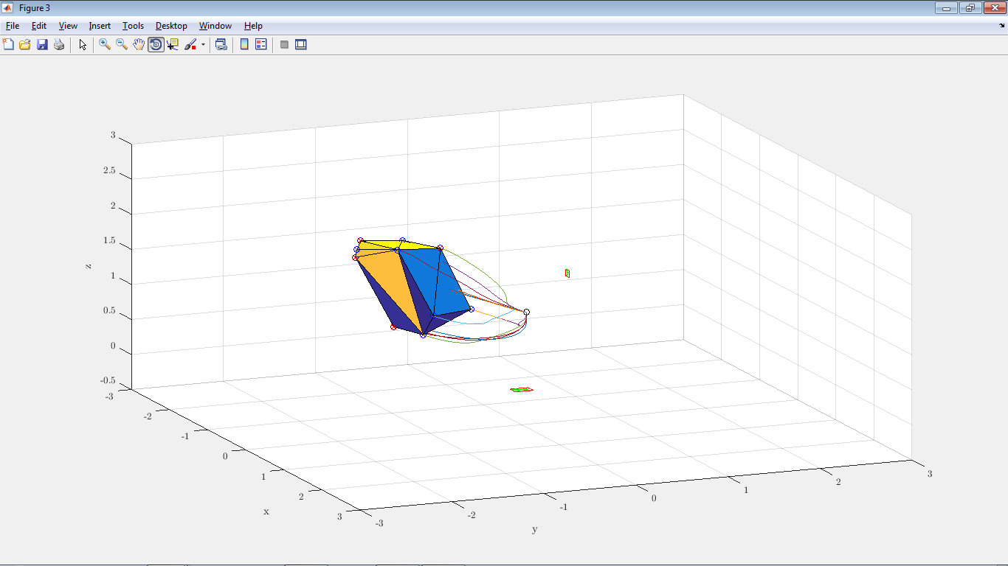
LP for finding CoMs
Finding allowed CoMs for a fixed CWC (and fixed ${\dot{r}}_{0},L_{0}$): LP program:

Slide 18
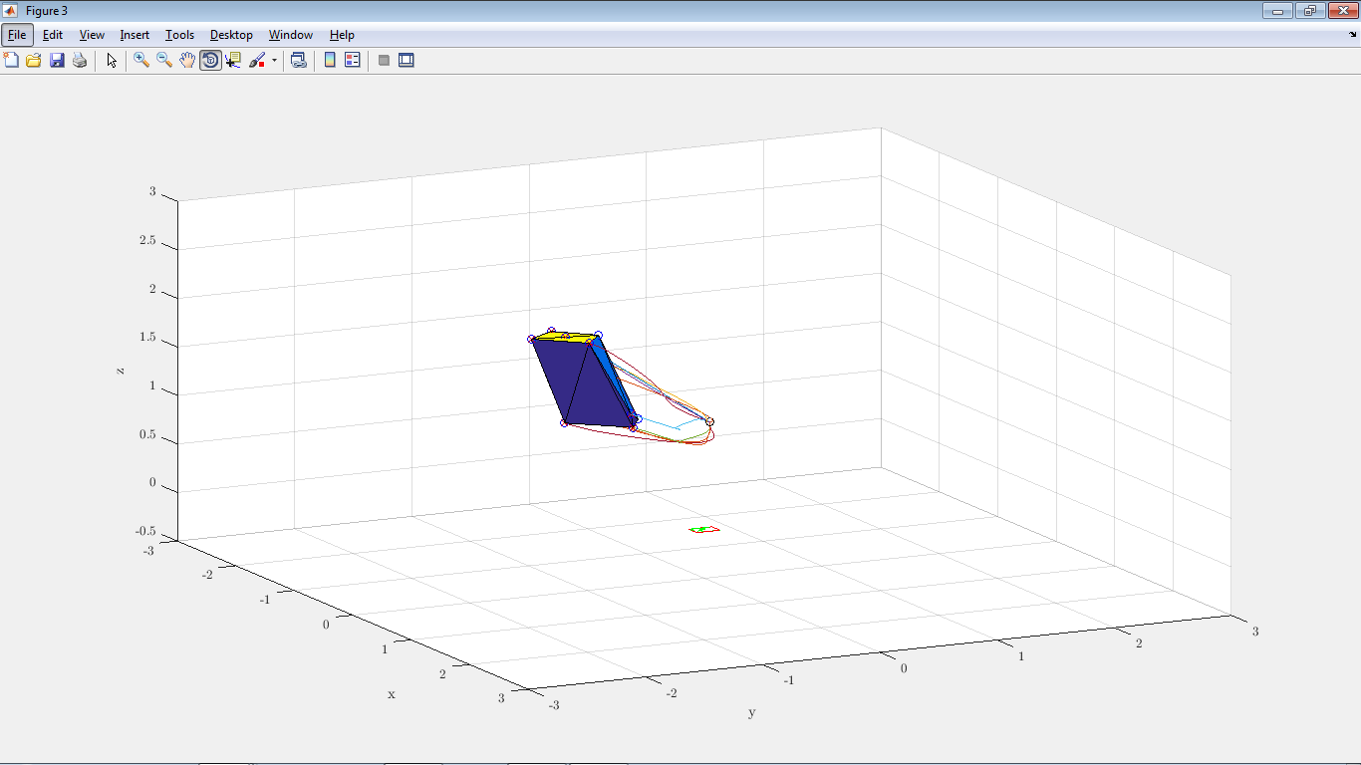
LP for finding CoMs
Without hand:

Slide 19
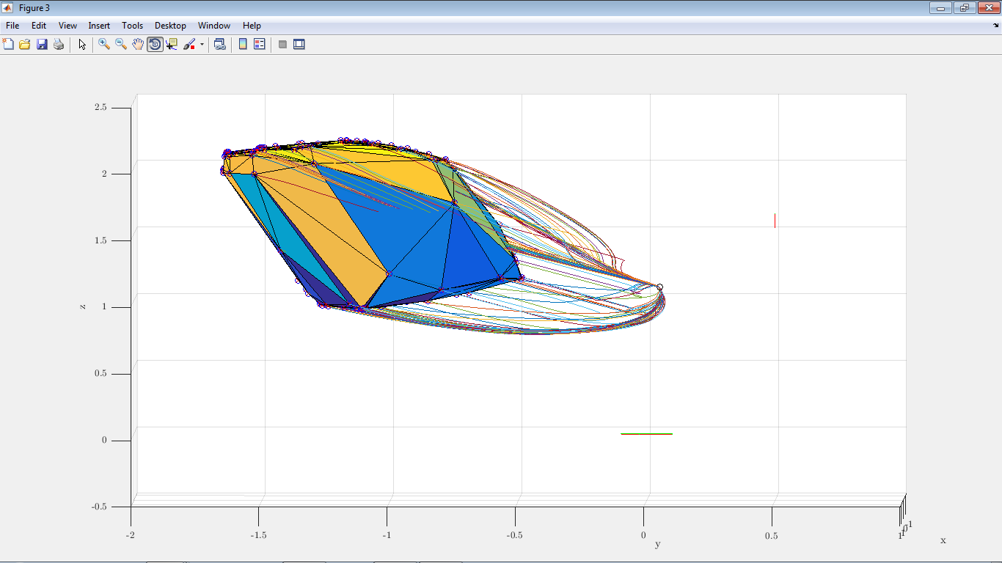
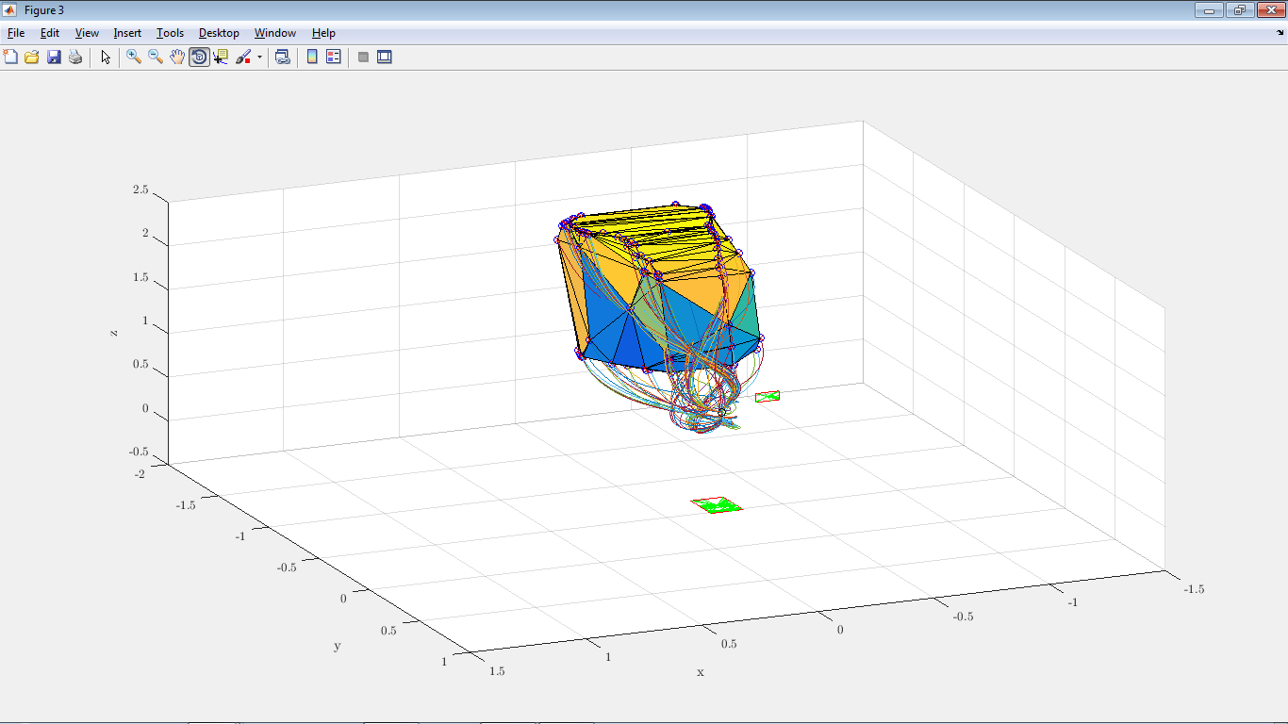
LP for finding CoMs
Finding allowed CoMs for a fixed CWC (and fixed ${\dot{r}}_{0},L_{0}$): LP program:

Slide 20
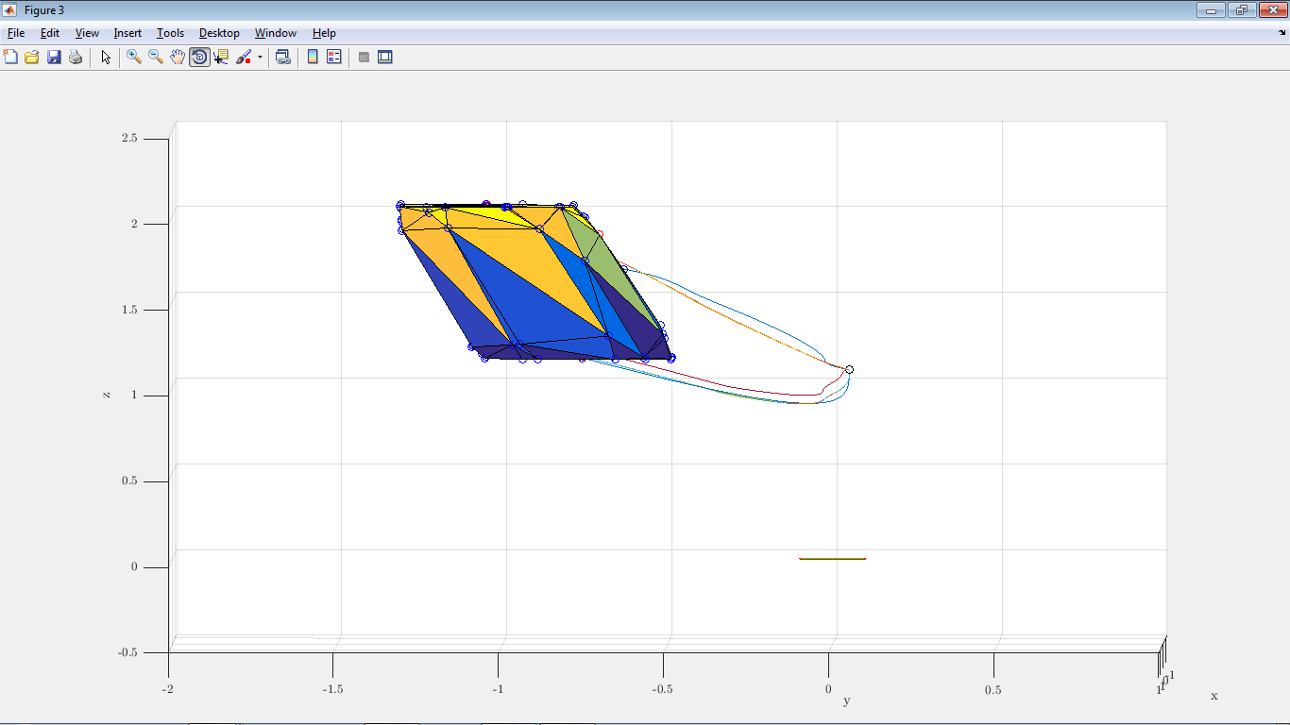
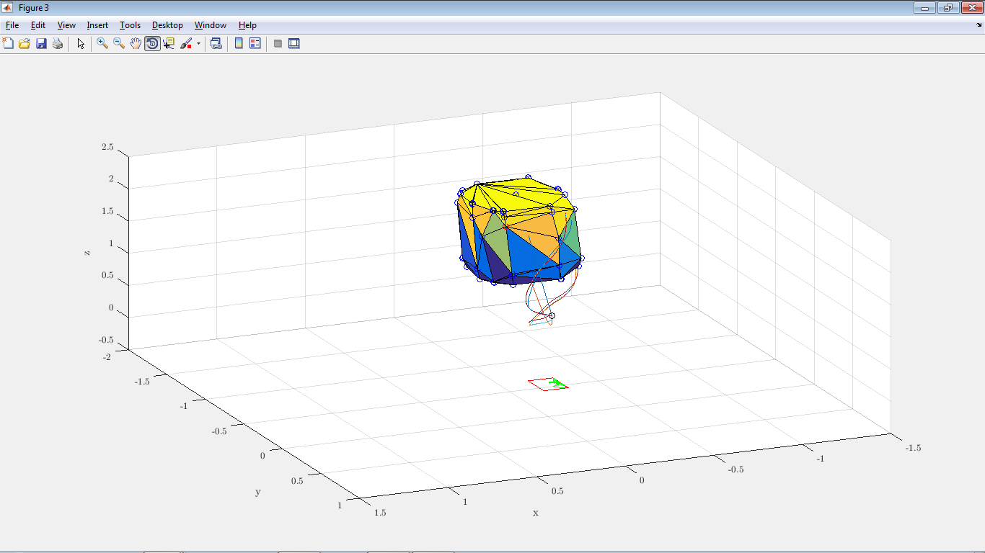
LP for finding CoMs
Without hand:

Slide 21
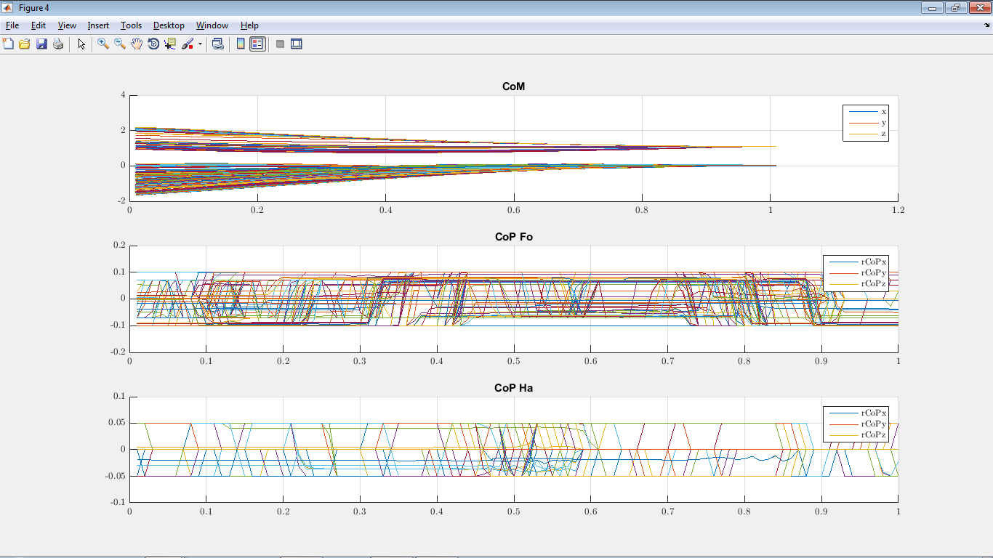
LP for finding CoMs
Finding allowed CoMs for a fixed CWC (and fixed ${\dot{r}}_{0},L_{0}$): LP program:

Slide 22




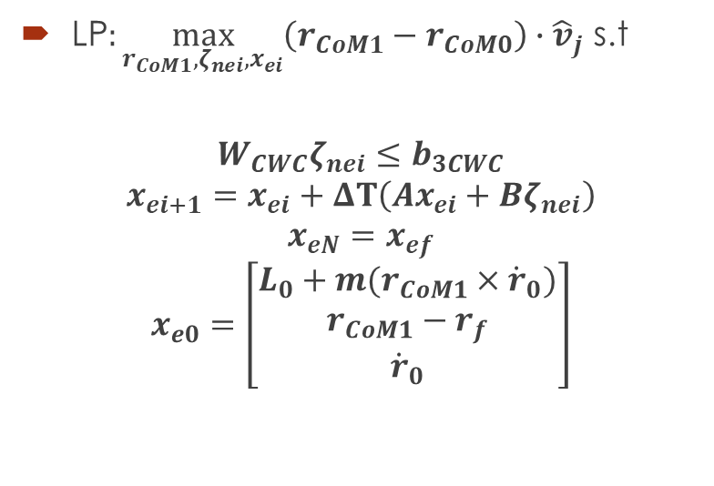

0-Step Capturability - FCD
Using the Full Centroidal Dynamics (FCD): If we can place instantaneously the foot, then we can step in the reflected region of:
LP$:\max_{r_{CoM1},ζ_{nei},x_{ei}}\left(r_{CoM1}−r_{CoM0}\right)∙{\hat{v}}_{j}$ s.t
$$W_{CWC}ζ_{nei}≤b_{3CWC}$$
$$x_{ei+1}=x_{ei}+ΔT\left(Ax_{ei}+Bζ_{nei}\right)$$
$$x_{eN}=x_{ef}$$
$$x_{e0}=\left[\begin{aligned}L_{0}+m(r_{CoM1}×{\dot{r}}_{0}) \\ r_{CoM1}−r_{f} \\ {\dot{r}}_{0}\end{aligned}\right]$$
$$r_{CoM0}$$
$$r_{CoM1}$$
$${\hat{v}}_{j}$$
$${\hat{v}}_{j}$$
$$ζ$$

Slide 23


0-Step Capturability w. Delay - FCD
If we can step after a given time $t_{st}$, then we can compute the states after this time:
$$\left\{\begin{aligned}\dot{L}=0 \\ \ddot{r}=g \end{aligned}\right.$$
$$\begin{matrix}L\left(t_{st}\right)=L_{0} \\ r\left(t_{st}\right)=r_{0}+{\dot{r}}_{0}t_{st}+\frac{1}{2}gt_{st}^{2} \\ \dot{r}\left(t_{st}\right)={\dot{r}}_{0}+gt_{st}\end{matrix}$$
$$r_{CoM0}$$
$$r_{CoM1}$$
$${\hat{v}}_{j}$$
$${\hat{v}}_{j}$$
$$ζ$$

Slide 24




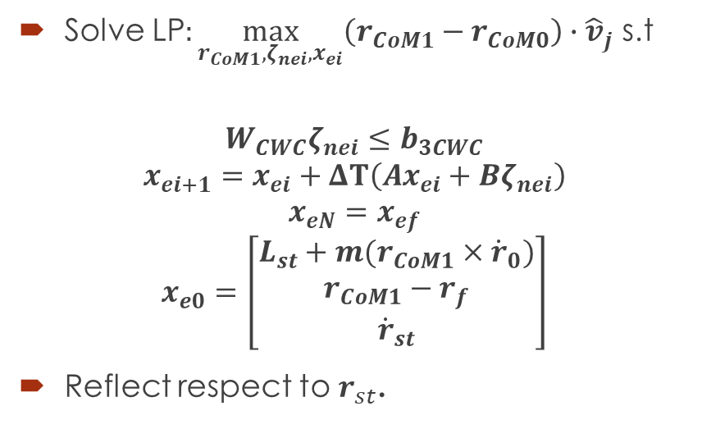

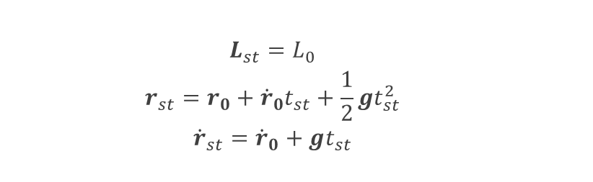
0-Step Capturability w. Delay - FCD
$$\begin{matrix}L_{st}=L_{0} \\ r_{st}=r_{0}+{\dot{r}}_{0}t_{st}+\frac{1}{2}gt_{st}^{2} \\ {\dot{r}}_{st}={\dot{r}}_{0}+gt_{st}\end{matrix}$$
Solve LP$:\max_{r_{CoM1},ζ_{nei},x_{ei}}\left(r_{CoM1}−r_{CoM0}\right)∙{\hat{v}}_{j}$ s.t
$$W_{CWC}ζ_{nei}≤b_{3CWC}$$
$$x_{ei+1}=x_{ei}+ΔT\left(Ax_{ei}+Bζ_{nei}\right)$$
$$x_{eN}=x_{ef}$$
$$x_{e0}=\left[\begin{aligned}L_{st}+m(r_{CoM1}×{\dot{r}}_{0}) \\ r_{CoM1}−r_{f} \\ {\dot{r}}_{st}\end{aligned}\right]$$
Reflect respect to $r_{st}$.
$$r_{CoM0}$$
$$r_{CoM1}$$
$${\hat{v}}_{j}$$
$${\hat{v}}_{j}$$
$$ζ$$

Slide 25

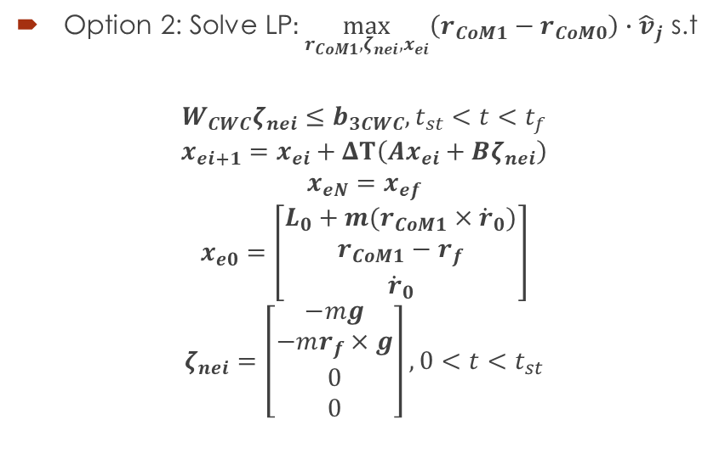




0-Step Capturability w. Delay - FCD
Option 2: Solve LP$:\max_{r_{CoM1},ζ_{nei},x_{ei}}\left(r_{CoM1}−r_{CoM0}\right)∙{\hat{v}}_{j}$ s.t
$$W_{CWC}ζ_{nei}≤b_{3CWC}, t_{st}<t<t_{f}$$
$$x_{ei+1}=x_{ei}+ΔT\left(Ax_{ei}+Bζ_{nei}\right)$$
$$x_{eN}=x_{ef}$$
$$x_{e0}=\left[\begin{aligned}L_{0}+m(r_{CoM1}×{\dot{r}}_{0}) \\ r_{CoM1}−r_{f} \\ {\dot{r}}_{0}\end{aligned}\right]$$
$$ζ_{nei}=\left[\begin{aligned}−mg \\ −mr_{f}×g \\ 0 \\ 0\end{aligned}\right], 0<t<t_{st}$$
$$r_{CoM0}$$
$$r_{CoM1}$$
$${\hat{v}}_{j}$$
$${\hat{v}}_{j}$$
$$ζ$$

Slide 26







1-Step Capturability – FCD
Where to place the next contact in order to get to complete rest:
$$ζ_{2}$$
$$ζ_{2}$$
$${\dot{r}}_{0}$$
$$L_{0}$$
???
$$r_{0}$$
$$ζ_{2}$$
$$ζ_{1}$$

Slide 27




1-Step Capturability – FCD
Let’s find the Next-Capture Point for a given planar surface.
$$ζ_{2}$$
$${\dot{r}}_{0}$$
$$L_{0}$$
$$ζ_{2}$$
$$r_{0}$$
$$ζ_{2}$$
$$ζ_{1}$$

Slide 28






1-Step Capturability – FCD
For rough terrain:
Define multiple planar surfaces (position, normal vector and coef. of friction)
Find CR on each planar surface.
$${\dot{r}}_{0}$$
$$L_{0}$$
$$r_{0}$$
$$ζ_{2}$$
$$ζ_{2}$$
$$ζ_{1}$$

Slide 29


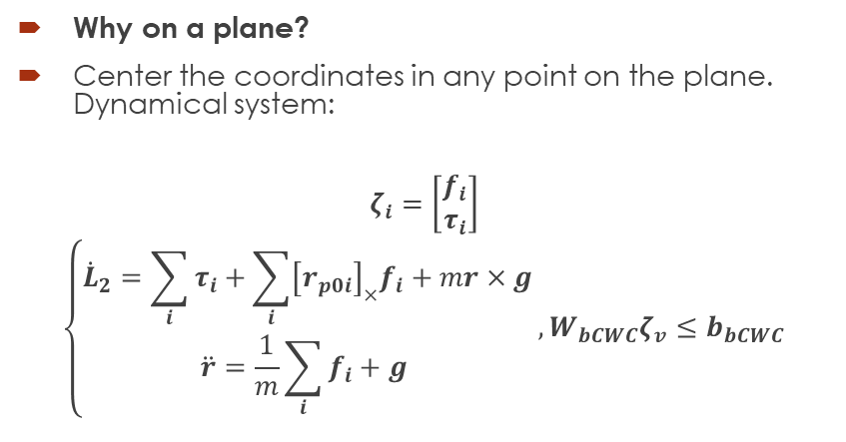





1-Step Capturability – FCD
Let’s find the Next-Capture Region for a given planar surface.
Why on a plane?
Center the coordinates in any point on the plane. Dynamical system:
$$ζ_{i}=\left[\begin{aligned}f_{i} \\ τ_{i}\end{aligned}\right]$$
$$\left\{\begin{aligned}{\dot{L}}_{2}=\sum_{i}{τ_{i}}+\sum_{i}{{\left[r_{p0i}\right]}_{×}f_{i}}+mr×g \\ \ddot{r}=\frac{1}{m}\sum_{i}{f_{i}}+g \end{aligned}\right.,W_{bCWC}ζ_{v}≤b_{bCWC}$$
$${\dot{r}}_{0}$$
$$L_{0}$$
$$r_{0}$$
$$r_{p02}$$
$$ζ_{2}$$
$$ζ_{1}$$
$$r_{p01}$$

Slide 30
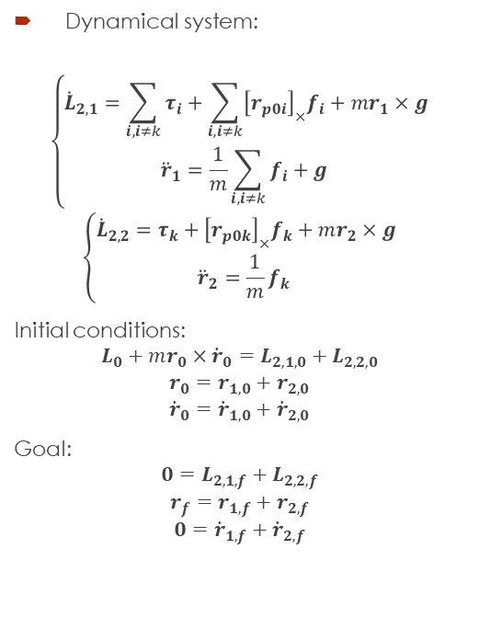
1-Step Capturability – FCD
Let’s find the Next-Capture Region for a given planar surface.
Dynamical system:
$$\left\{\begin{aligned}{\dot{L}}_{2,1}=\sum_{i, i≠k}{τ_{i}}+\sum_{i, i≠k}{{\left[r_{p0i}\right]}_{×}f_{i}}+mr_{1}×g \\ {\ddot{r}}_{1}=\frac{1}{m}\sum_{i, i≠k}{f_{i}}+g \end{aligned}\right.$$
$$\left\{\begin{aligned}{\dot{L}}_{2,2}=τ_{k}+{\left[r_{p0k}\right]}_{×}f_{k}+mr_{2}×g \\ {\ddot{r}}_{2}=\frac{1}{m}f_{k} \end{aligned}\right.$$
Initial conditions:
$$L_{0}+mr_{0}×{\dot{r}}_{0}=L_{2,1,0}+L_{2,2,0}$$
$$r_{0}=r_{1,0}+r_{2,0}$$
$${\dot{r}}_{0}={\dot{r}}_{1,0}+{\dot{r}}_{2,0}$$
Goal:
$$0=L_{2,1,f}+L_{2,2,f}$$
$$r_{f}=r_{1,f}+r_{2,f}$$
$$0={\dot{r}}_{1,f}+{\dot{r}}_{2,f}$$
$${\dot{r}}_{0}$$
$$L_{0}$$
$$r_{0}$$
$$r_{p02}$$
$$ζ_{2}$$
$$ζ_{1}$$
$$r_{p01}$$

Slide 31
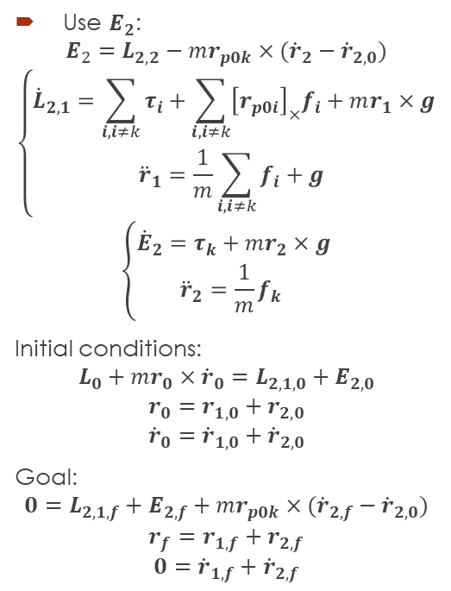
1-Step Capturability – FCD
Let’s find the Next-Capture Region for a given planar surface.
Use $E_{2}$:
$$E_{2}=L_{2,2}−mr_{p0k}×({\dot{r}}_{2}−{\dot{r}}_{2,0})$$
$$\left\{\begin{aligned}{\dot{L}}_{2,1}=\sum_{i, i≠k}{τ_{i}}+\sum_{i, i≠k}{{\left[r_{p0i}\right]}_{×}f_{i}}+mr_{1}×g \\ {\ddot{r}}_{1}=\frac{1}{m}\sum_{i, i≠k}{f_{i}}+g \end{aligned}\right.$$
$$\left\{\begin{aligned}{\dot{E}}_{2}=τ_{k}+mr_{2}×g \\ {\ddot{r}}_{2}=\frac{1}{m}f_{k} \end{aligned}\right.$$
Initial conditions:
$$L_{0}+mr_{0}×{\dot{r}}_{0}=L_{2,1,0}+E_{2,0}$$
$$r_{0}=r_{1,0}+r_{2,0}$$
$${\dot{r}}_{0}={\dot{r}}_{1,0}+{\dot{r}}_{2,0}$$
Goal:
$$0=L_{2,1,f}+E_{2,f}+mr_{p0k}×({\dot{r}}_{2,f}−{\dot{r}}_{2,0})$$
$$r_{f}=r_{1,f}+r_{2,f}$$
$$0={\dot{r}}_{1,f}+{\dot{r}}_{2,f}$$
$${\dot{r}}_{0}$$
$$L_{0}$$
$$r_{0}$$
$$r_{p02}$$
$$ζ_{2}$$
$$ζ_{1}$$
$$r_{p01}$$

Slide 32

1-Step Capturability – FCD
Let’s find the Next-Capture Region for a given planar surface.
Why only in a Plane?
In the space:
$$0=L_{2,1,f}+E_{2,f}+mr_{p0k}×({\dot{r}}_{2,f}−{\dot{r}}_{2,0})$$
If $r_{p0k}$ is a Next-Capture Point, then $r_{p0k}+λ({\dot{r}}_{2,f}−{\dot{r}}_{2,0})$ is also a Next-Capture Point.
$$r_{p0k}+λ\left({\dot{r}}_{2,f}−{\dot{r}}_{2,0}\right)=r_{p0k}+λ\int_{0}^{t_{f}}{f_{k}dt}$$
$${\hat{n}}_{k}∙r_{p0k}=0$$
$${\dot{r}}_{0}$$
$$L_{0}$$
$$r_{0}$$
$$r_{p02}$$
$$ζ_{2}$$
$$ζ_{1}$$
$$r_{p01}$$

Slide 33
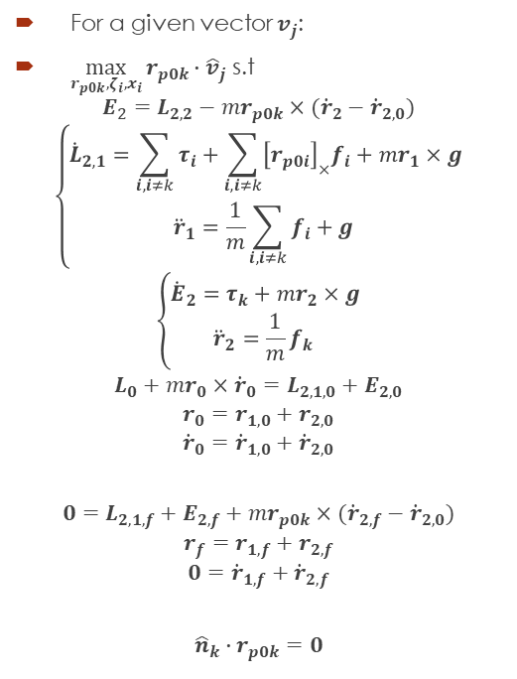
1-Step Capturability – FCD
Non-Linear Program for finding vertex of allowed hand positions:
For a given vector $v_{j}$:
$\max_{r_{p0k},ζ_{i},x_{i}}{r_{p0k}∙{\hat{v}}_{j}}$ s.t
$$E_{2}=L_{2,2}−mr_{p0k}×({\dot{r}}_{2}−{\dot{r}}_{2,0})$$
$$\left\{\begin{aligned}{\dot{L}}_{2,1}=\sum_{i, i≠k}{τ_{i}}+\sum_{i, i≠k}{{\left[r_{p0i}\right]}_{×}f_{i}}+mr_{1}×g \\ {\ddot{r}}_{1}=\frac{1}{m}\sum_{i, i≠k}{f_{i}}+g \end{aligned}\right.$$
$$\left\{\begin{aligned}{\dot{E}}_{2}=τ_{k}+mr_{2}×g \\ {\ddot{r}}_{2}=\frac{1}{m}f_{k} \end{aligned}\right.$$
$$L_{0}+mr_{0}×{\dot{r}}_{0}=L_{2,1,0}+E_{2,0}$$
$$r_{0}=r_{1,0}+r_{2,0}$$
$${\dot{r}}_{0}={\dot{r}}_{1,0}+{\dot{r}}_{2,0}$$
$$0=L_{2,1,f}+E_{2,f}+mr_{p0k}×({\dot{r}}_{2,f}−{\dot{r}}_{2,0})$$
$$r_{f}=r_{1,f}+r_{2,f}$$
$$0={\dot{r}}_{1,f}+{\dot{r}}_{2,f}$$
$${\hat{n}}_{k}∙r_{p0k}=0$$
$${\dot{r}}_{0}$$
$$L_{0}$$
$$r_{0}$$
$$r_{p02}$$
$$ζ_{2}$$
$$ζ_{1}$$
$$r_{p01}$$

Slide 34

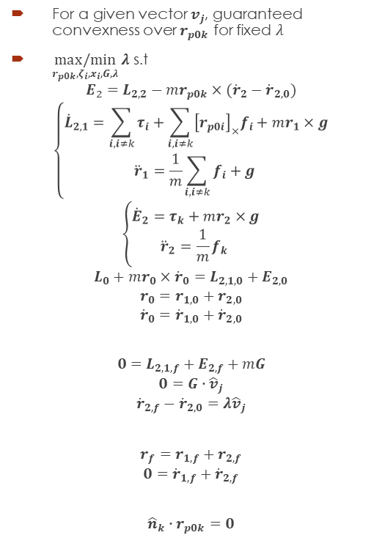
1-Step Capturability – FCD
Linear Program for finding some allowed hand positions:
For a given vector $v_{j}$, guaranteed convexness over $r_{p0k}$ for fixed $λ$
$\underset{r_{p0k},ζ_{i},x_{i},G,λ}{max/min}{λ}$ s.t
$$E_{2}=L_{2,2}−mr_{p0k}×({\dot{r}}_{2}−{\dot{r}}_{2,0})$$
$$\left\{\begin{aligned}{\dot{L}}_{2,1}=\sum_{i, i≠k}{τ_{i}}+\sum_{i, i≠k}{{\left[r_{p0i}\right]}_{×}f_{i}}+mr_{1}×g \\ {\ddot{r}}_{1}=\frac{1}{m}\sum_{i, i≠k}{f_{i}}+g \end{aligned}\right.$$
$$\left\{\begin{aligned}{\dot{E}}_{2}=τ_{k}+mr_{2}×g \\ {\ddot{r}}_{2}=\frac{1}{m}f_{k} \end{aligned}\right.$$
$$L_{0}+mr_{0}×{\dot{r}}_{0}=L_{2,1,0}+E_{2,0}$$
$$r_{0}=r_{1,0}+r_{2,0}$$
$${\dot{r}}_{0}={\dot{r}}_{1,0}+{\dot{r}}_{2,0}$$
$$0=L_{2,1,f}+E_{2,f}+mG$$
$$0=G∙{\hat{v}}_{j}$$
$${\dot{r}}_{2,f}−{\dot{r}}_{2,0}=λ{\hat{v}}_{j}$$
$$r_{f}=r_{1,f}+r_{2,f}$$
$$0={\dot{r}}_{1,f}+{\dot{r}}_{2,f}$$
$${\hat{n}}_{k}∙r_{p0k}=0$$
$${\dot{r}}_{0}$$
$$L_{0}$$
$$r_{0}$$
$$r_{p02}$$
$$ζ_{2}$$
$$r_{p0k}=\frac{{\hat{n}}_{k}×G}{{\hat{n}}_{k}∙({\dot{r}}_{2,f}−{\dot{r}}_{2,0})}$$
$$ζ_{1}$$
$$r_{p01}$$

Slide 35
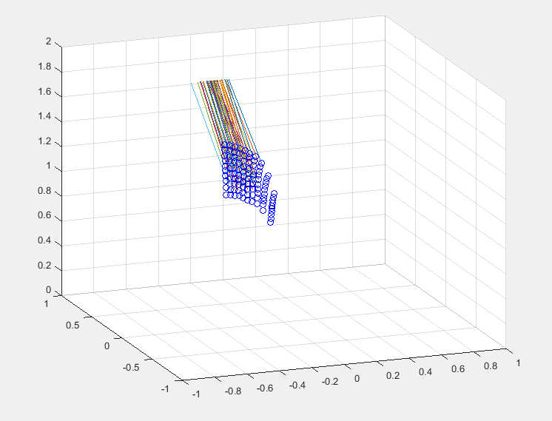

1-Step Capturability – FCD
Linear Program for finding some allowed hand positions:
For a given vector $v_{j}$, guaranteed convexness over $r_{p0k}$ for fixed $λ$
$\underset{r_{p0k},ζ_{i},x_{i},G,λ}{max/min}{λ}$ s.t
$$E_{2}=L_{2,2}−mr_{p0k}×({\dot{r}}_{2}−{\dot{r}}_{2,0})$$
$$\left\{\begin{aligned}{\dot{L}}_{2,1}=\sum_{i, i≠k}{τ_{i}}+\sum_{i, i≠k}{{\left[r_{p0i}\right]}_{×}f_{i}}+mr_{1}×g \\ {\ddot{r}}_{1}=\frac{1}{m}\sum_{i, i≠k}{f_{i}}+g \end{aligned}\right.$$
$$\left\{\begin{aligned}{\dot{E}}_{2}=τ_{k}+mr_{2}×g \\ {\ddot{r}}_{2}=\frac{1}{m}f_{k} \end{aligned}\right.$$
$$L_{0}+mr_{0}×{\dot{r}}_{0}=L_{2,1,0}+E_{2,0}$$
$$r_{0}=r_{1,0}+r_{2,0}$$
$${\dot{r}}_{0}={\dot{r}}_{1,0}+{\dot{r}}_{2,0}$$
$$0=L_{2,1,f}+E_{2,f}+mG$$
$$0=G∙{\hat{v}}_{j}$$
$${\dot{r}}_{2,f}−{\dot{r}}_{2,0}=λ{\hat{v}}_{j}$$
$$r_{f}=r_{1,f}+r_{2,f}$$
$$0={\dot{r}}_{1,f}+{\dot{r}}_{2,f}$$
$${\hat{n}}_{k}∙r_{p0k}=0$$
$$r_{p0k}=\frac{{\hat{n}}_{k}×G}{{\hat{n}}_{k}∙({\dot{r}}_{2,f}−{\dot{r}}_{2,0})}$$

Slide 36
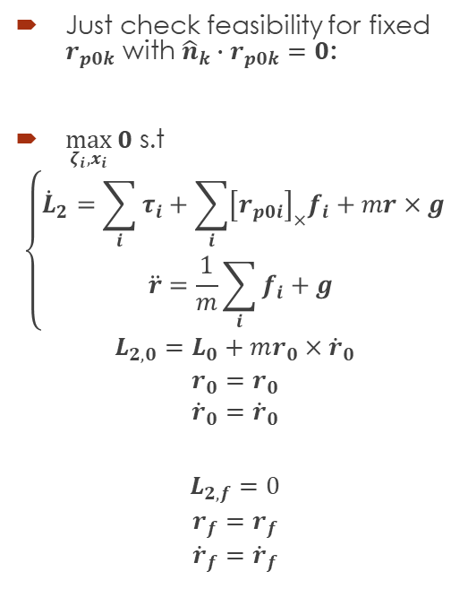
1-Step Capturability – FCD
Linear Program for finding vertex of allowed hand positions:
Just check feasibility for fixed $r_{p0k}$ with ${\hat{n}}_{k}∙r_{p0k}=0$:
$\max_{ζ_{i},x_{i}}{0}$ s.t
$$\left\{\begin{aligned}{\dot{L}}_{2}=\sum_{i}{τ_{i}}+\sum_{i}{{\left[r_{p0i}\right]}_{×}f_{i}}+mr×g \\ \ddot{r}=\frac{1}{m}\sum_{i}{f_{i}}+g \end{aligned}\right.$$
$$L_{2,0}=L_{0}+mr_{0}×{\dot{r}}_{0}$$
$$r_{0}=r_{0}$$
$${\dot{r}}_{0}={\dot{r}}_{0}$$
$$L_{2,f}=0$$
$$r_{f}=r_{f}$$
$${\dot{r}}_{f}={\dot{r}}_{f}$$
$${\dot{r}}_{0}$$
$$L_{0}$$
$$r_{0}$$
$$r_{p02}$$
$$ζ_{2}$$
$$ζ_{1}$$
$$r_{p01}$$

Slide 37
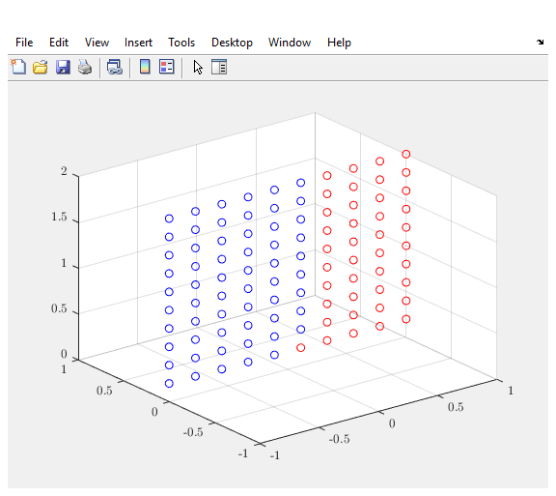
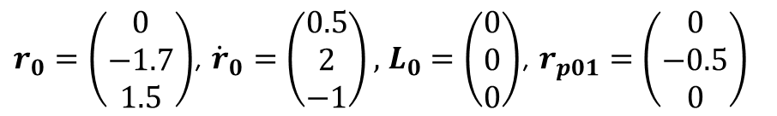
1-Step Capturability – FCD
Linear Program for finding vertex of allowed hand positions:
$r_{0}=\left(\begin{aligned}0 \\ −1.7 \\ 1.5\end{aligned}\right)$, ${\dot{r}}_{0}=\left(\begin{aligned}0.5 \\ 2 \\ −1\end{aligned}\right),$ $L_{0}=\left(\begin{aligned}0 \\ 0 \\ 0\end{aligned}\right)$, $r_{p01}=\left(\begin{aligned}0 \\ −0.5 \\ 0\end{aligned}\right)$
Just check feasibility for fixed $r_{p0k}$ with ${\hat{n}}_{k}∙r_{p0k}=0$:
$\max_{ζ_{i},x_{i}}{0}$ s.t
$$\left\{\begin{aligned}{\dot{L}}_{2}=\sum_{i}{τ_{i}}+\sum_{i}{{\left[r_{p0i}\right]}_{×}f_{i}}+mr×g \\ \ddot{r}=\frac{1}{m}\sum_{i}{f_{i}}+g \end{aligned}\right.$$
$$L_{2,0}=L_{0}+mr_{0}×{\dot{r}}_{0}$$
$$r_{0}=r_{0}$$
$${\dot{r}}_{0}={\dot{r}}_{0}$$
$$L_{2,f}=0$$
$$r_{f}=r_{f}$$
$${\dot{r}}_{f}={\dot{r}}_{f}$$

Slide 38
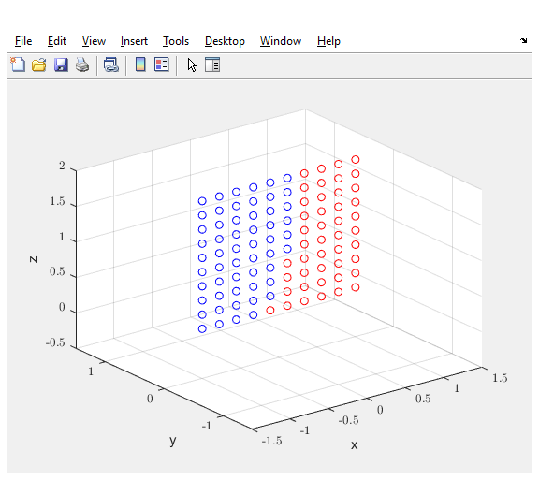
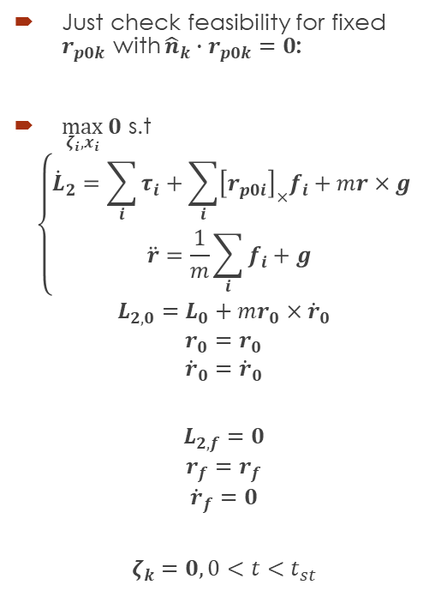
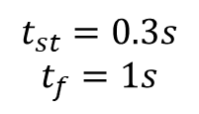
1-Step Capturability – FCD
Linear Program for finding vertex of allowed hand positions with time delay:
$$t_{st}=0.3s$$
$$t_{f}=1s$$
Just check feasibility for fixed $r_{p0k}$ with ${\hat{n}}_{k}∙r_{p0k}=0$:
$\max_{ζ_{i},x_{i}}{0}$ s.t
$$\left\{\begin{aligned}{\dot{L}}_{2}=\sum_{i}{τ_{i}}+\sum_{i}{{\left[r_{p0i}\right]}_{×}f_{i}}+mr×g \\ \ddot{r}=\frac{1}{m}\sum_{i}{f_{i}}+g \end{aligned}\right.$$
$$L_{2,0}=L_{0}+mr_{0}×{\dot{r}}_{0}$$
$$r_{0}=r_{0}$$
$${\dot{r}}_{0}={\dot{r}}_{0}$$
$$L_{2,f}=0$$
$$r_{f}=r_{f}$$
$${\dot{r}}_{f}=0$$
$$ζ_{k}=0, 0<t<t_{st}$$

Slide 39
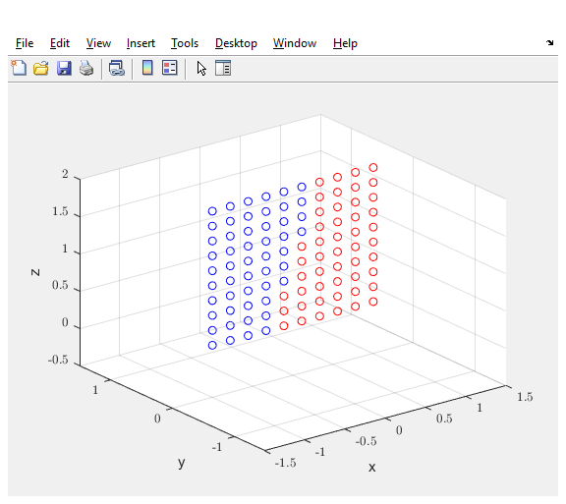
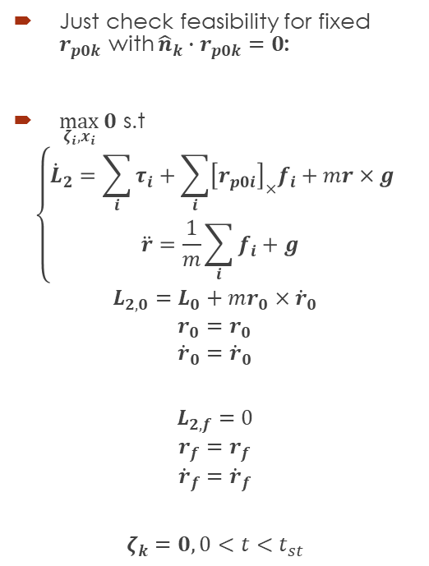
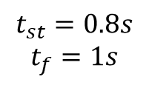
1-Step Capturability – FCD
Linear Program for finding vertex of allowed hand positions with time delay:
$$t_{st}=0.8s$$
$$t_{f}=1s$$
Just check feasibility for fixed $r_{p0k}$ with ${\hat{n}}_{k}∙r_{p0k}=0$:
$\max_{ζ_{i},x_{i}}{0}$ s.t
$$\left\{\begin{aligned}{\dot{L}}_{2}=\sum_{i}{τ_{i}}+\sum_{i}{{\left[r_{p0i}\right]}_{×}f_{i}}+mr×g \\ \ddot{r}=\frac{1}{m}\sum_{i}{f_{i}}+g \end{aligned}\right.$$
$$L_{2,0}=L_{0}+mr_{0}×{\dot{r}}_{0}$$
$$r_{0}=r_{0}$$
$${\dot{r}}_{0}={\dot{r}}_{0}$$
$$L_{2,f}=0$$
$$r_{f}=r_{f}$$
$${\dot{r}}_{f}={\dot{r}}_{f}$$
$$ζ_{k}=0, 0<t<t_{st}$$

Slide 40
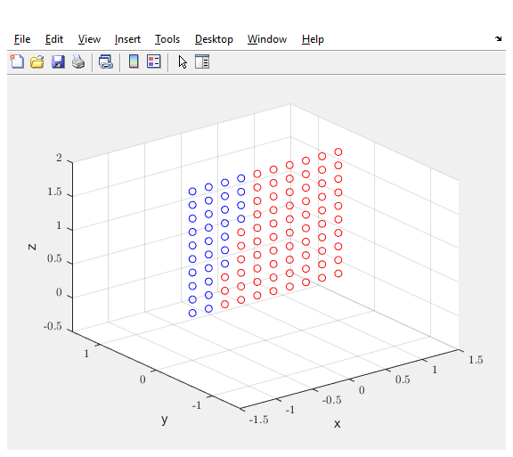
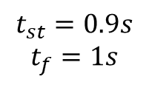
1-Step Capturability – FCD
Linear Program for finding vertex of allowed hand positions with time delay:
$$t_{st}=0.9s$$
$$t_{f}=1s$$
Just check feasibility for fixed $r_{p0k}$ with ${\hat{n}}_{k}∙r_{p0k}=0$:
$\max_{ζ_{i},x_{i}}{0}$ s.t
$$\left\{\begin{aligned}{\dot{L}}_{2}=\sum_{i}{τ_{i}}+\sum_{i}{{\left[r_{p0i}\right]}_{×}f_{i}}+mr×g \\ \ddot{r}=\frac{1}{m}\sum_{i}{f_{i}}+g \end{aligned}\right.$$
$$L_{2,0}=L_{0}+mr_{0}×{\dot{r}}_{0}$$
$$r_{0}=r_{0}$$
$${\dot{r}}_{0}={\dot{r}}_{0}$$
$$L_{2,f}=0$$
$$r_{f}=r_{f}$$
$${\dot{r}}_{f}={\dot{r}}_{f}$$
$$ζ_{k}=0, 0<t<t_{st}$$

Slide 41
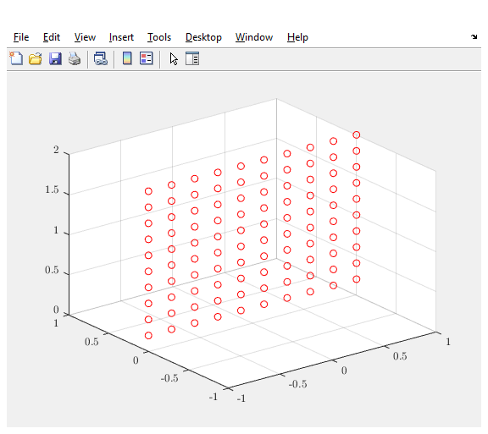
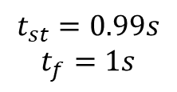
1-Step Capturability – FCD
Linear Program for finding vertex of allowed hand positions with time delay:
$$t_{st}=0.99s$$
$$t_{f}=1s$$
Just check feasibility for fixed $r_{p0k}$ with ${\hat{n}}_{k}∙r_{p0k}=0$:
$\max_{ζ_{i},x_{i}}{0}$ s.t
$$\left\{\begin{aligned}{\dot{L}}_{2}=\sum_{i}{τ_{i}}+\sum_{i}{{\left[r_{p0i}\right]}_{×}f_{i}}+mr×g \\ \ddot{r}=\frac{1}{m}\sum_{i}{f_{i}}+g \end{aligned}\right.$$
$$L_{2,0}=L_{0}+mr_{0}×{\dot{r}}_{0}$$
$$r_{0}=r_{0}$$
$${\dot{r}}_{0}={\dot{r}}_{0}$$
$$L_{2,f}=0$$
$$r_{f}=r_{f}$$
$${\dot{r}}_{f}={\dot{r}}_{f}$$
$$ζ_{k}=0, 0<t<t_{st}$$

Slide 42
Next?
Consider Impacts.
Simulations with planning.
Angular momentum.
Mix everything?
Thanks!

